Slide 1
SHAKS USB Tester v2 Manual

Slide 2
Shortened testing process
After running the app, connect the gamepad in USB mode for testing.
→ Connect while pressing the LB + SELECT key.
The gamepad will check the new connection and send you a message asking for permission. If you normally gather the necessary information, the gamepad test screen will appear immediately.
If a problem occurs due to a cable break during the test, showing STOP! message.
But, when all button/trigger/stick tests are done, disconnect the cable and turn on the gamepad.
When disconnected gamepad, the Bluetooth search is performed automatically. Be sure to turn on the gamepad to make sure it can be searched using the Bluetooth function.
When the search is complete, you can see the Bluetooth RSSI value of the device and a notice that all tests have been successfully completed.

Slide 3
Gamepad Test Application
Installation requirement
Basic requirement
Over Android OS 6
Bluetooth must be required
Required Location permission for Bluetooth Device Scanning.
In order to test quickly, Keyboard or other input device must be required.

Slide 4
Gamepad Test Application
How to install on PC
Download the “Usb Tester v2.0.apk” via ADB command on PC
Run “Command Prompt(cmd)” or “Windows PowerShell”.
Command : adb install “UsbTester 2.0.apk”
It’ll take a long time to down and install.
Condition
Possible to install Using cmd or PowerShell
When input “adb devices”, At least one connected device should be displayed.

Slide 5
Gamepad Test Application
How to install on Android device
Download APK on Android device like Tab or mobile phone
Download APK file
when you use by PC, you should check “MTP mode”.
Execute File Manager and click the APK
Install the APK
Condition
If the device not allow to install non-official apps.
you should make sure “ installation of non-official apps” or “ unknown sources

Slide 6
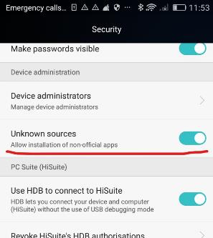
Gamepad Test Application
How to set for allowing Unknown Sources
Normally
System Set-up > click “Security”
Turn on Unknown sources

Slide 7
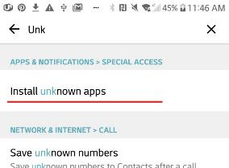
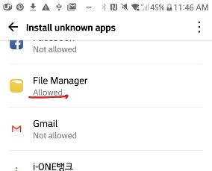
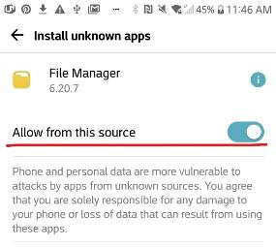
Gamepad Test Application
How to set for allowing Unknown Sources
In case of restrict each apps.
System set-up > Apps & Notifications > Special Access > Install unknown apps
Click APK
Allow from this source

Slide 8
Gamepad Test Application
How to set for allowing Unknown Sources
In case of restrict each apps.
System set-up > Apps & Notifications > Special Access > Install unknown apps
Click APK
Allow from this source

Slide 9
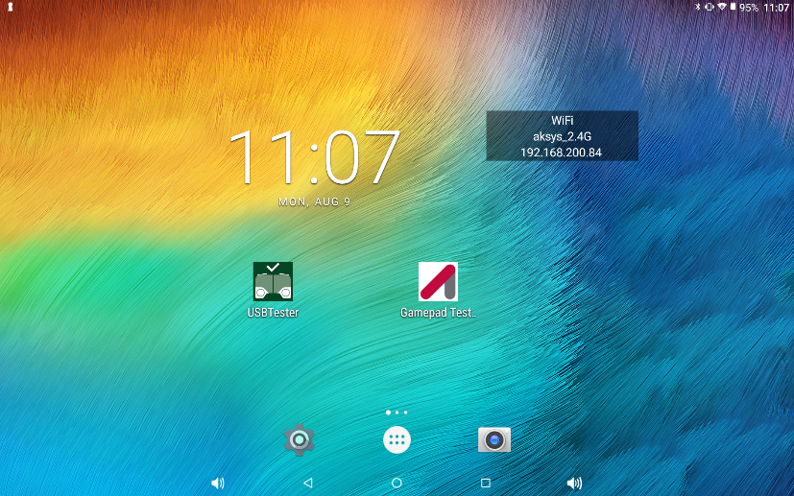
Launch App.

Slide 10
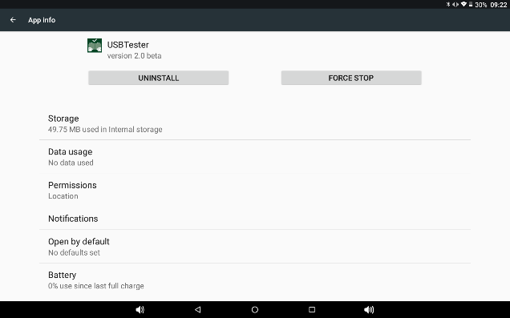
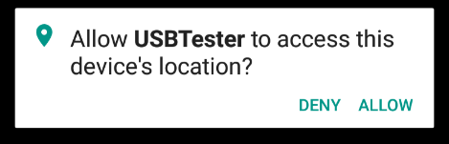
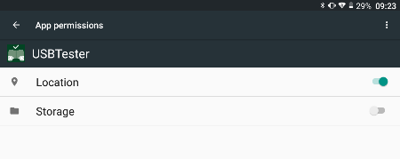
Reference.
Gamepad Test Application
Application Needs Location Permission for Bluetooth Scanning. It’s not used GPS.

Slide 11
Reference.
Gamepad Test Application
Use the screen horizontally.
Check if USB recognition is normal.
When the USB connection with the gamepad is disconnected, it automatically starts searching for Bluetooth.

Slide 12
Reference.
Gamepad Test Application
Green Color Object is relating to TEST SUCCESS.
Purple Color Object is relating to TEST FAILURE.
Orange Color Object is a reference to work progress.

Slide 13
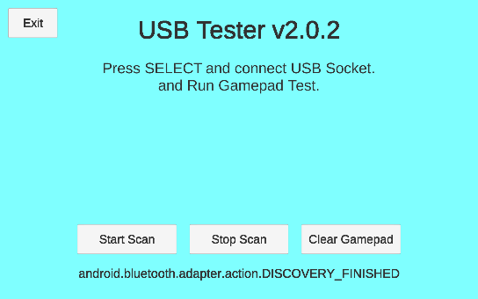
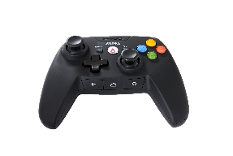
USB Tester 2.0
Connect gamepad via usb cable with debug-mode.
To enter the debug mode,
you must connect the cable while holding the LB button and SELECT.

Slide 14
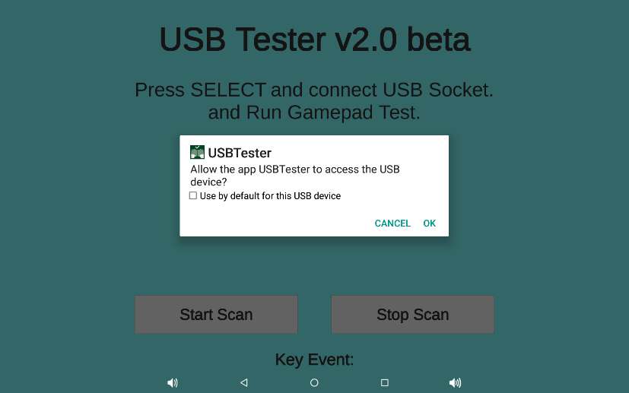
USB Tester 2.0
PLEASE PRESS OK!
If you press Cancel or click out of the window, the test cannot proceed.
You will need to reconnect the gamepad.

Slide 15
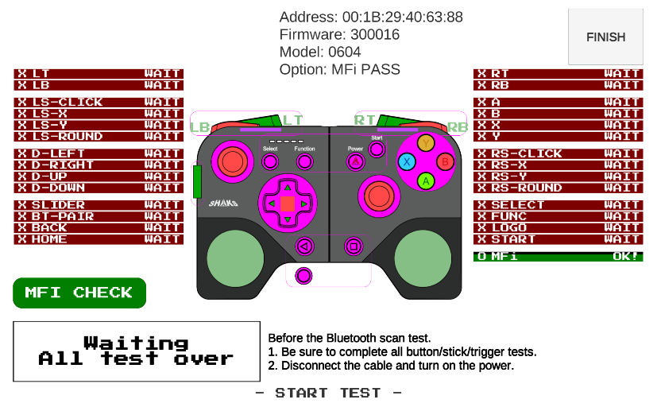
UI Information
Gamepad Information
If stop test and
go to main.
BUTTON /
STICK /
TRIGGER
TEST LIST
BLUETOOTH
TEST
LOG MESSAGE

Slide 16
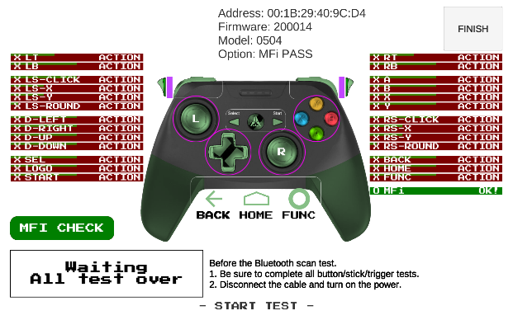
Check Device Information.
Before the test, Please check Gamepad’s Device information.
Model | Model Name
00 | - Unknown -
01 | TIMGamepad v2 (Now not support)
02 | SHAKS S2 (Now not support)
03 | SHAKS S3x
04 | SHAKS S4x
05 | SHAKS S2x
06 | SHAKS S5x
11 | PartnerTV Gamepad
12 | POST gamepad
13 | topp Gaming Miracle
14 | JGC100
Code | Device Option
00 | No Option
01 | IMU Sensor (for -s)
02 | Audio
04 | MFi (for -i)
05 | MFi + IMU
06 | MFi + Audio
07 | MFi + IMU + Audio
Example)
SHAKS S2s → 0501
SHAKS S3i → 0304
SHAKS S5b → 0600
You can see on the screen that the basic operation according to the model options worked well.
Please stop testing if something is not working.

Slide 17
Event Meter (ver.2)
You can check whether each item passes as shown below.
Meter 1
Meter 2
X
LT
0
Success
Test Name
Test Value
Meter 1: Success from Event Types.
Button / Triggers
Release / Zero
Press / +255
Stick
Stick Zero
Moved -127
Moved +127
Events
Ready
Event Detected
Slider / Rounds
Level 0
Level 1
…
Level N
Meter 2: Values Graph.
Trigger
Value Gauge
Stick
Value Gauge
- Value
+ Value

Slide 18
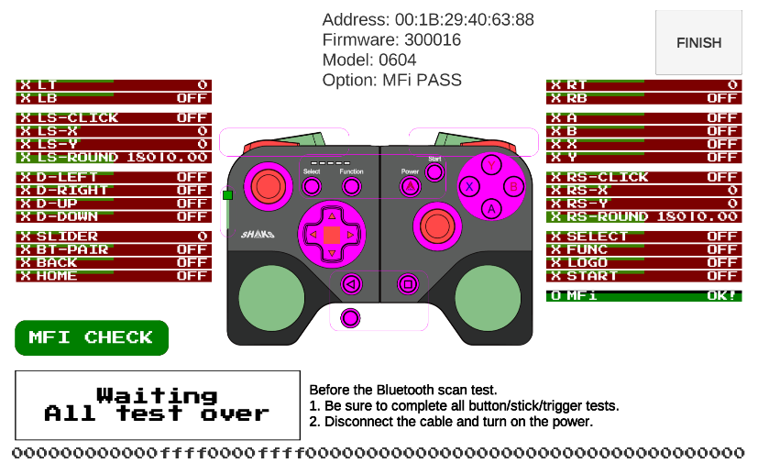
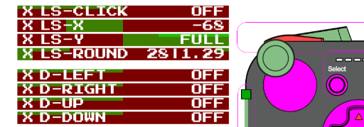





Axis Value Check
Left Stick (LS) and Right Stick (RS) can be moved up and down.
The stick must also be able to move sufficiently in almost any direction.
The stick must be able to hold the center exactly and be able to accurately represent the top, bottom, left and right.
Finally, each stick must be clickable.
LS/RS-ROUND indicates whether it moves in 16 directions. Move the stick a little slowly to make sure it moves in all directions.
IF All tested, show PASS.
FAIL ISSUE: No Zero(Center), No Full Up/Down/Left/Right, Round Distance

Slide 19
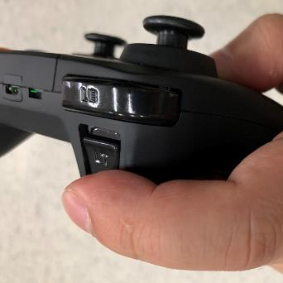
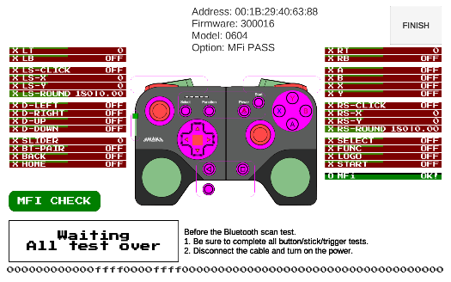
Trigger Button Check
Deeply
Press LT(L2) / RT(R2)
If shown “FULL”, release it.
If values go to zero, all test is success.
if not shown all green, may be not success in release test.
Value Zero. (Not Pressed)
Value Zero
Full Pressed
Press Harder
Value Gauge
Full Pressed.
Working Vibration.
Release to 0.
Success!
Off Vibration (PASS)

Slide 20
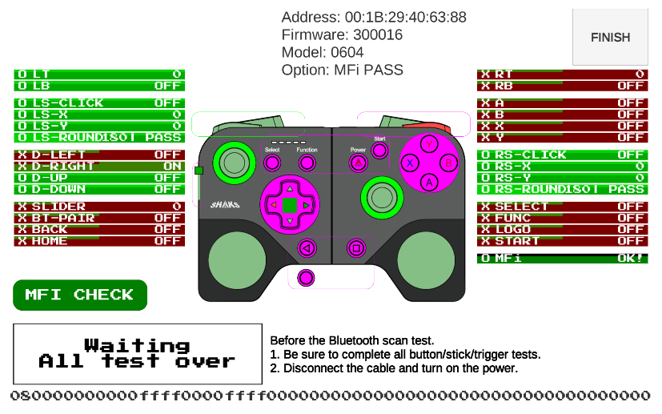
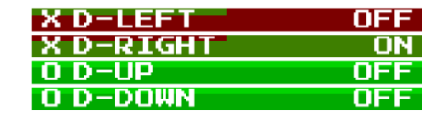
Button Check
You should click over one time and check the color change to green.
If there be no color change, it FAIL
Not Pressed
Pressing
Success
Success

Slide 21
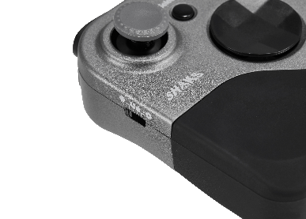
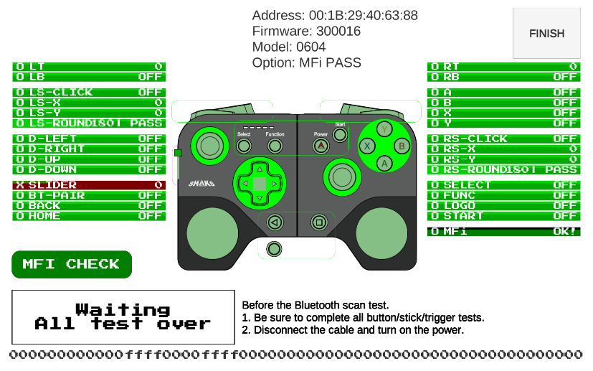

Slider Check (For S5)
You should move slider and change to green.
If there be no color change, it FAIL
Set Android
Set Windows
Set iOS
Set Mapping
Please don’t move faster.
Move smoothly.

Slide 22
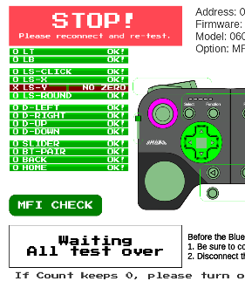
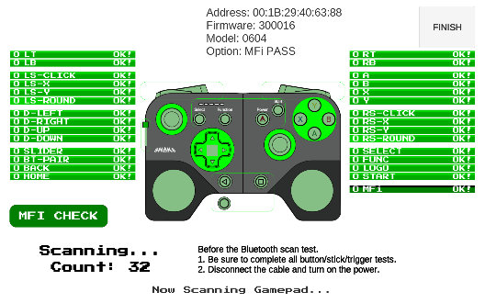
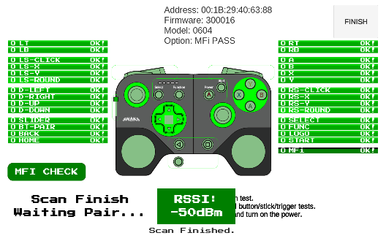
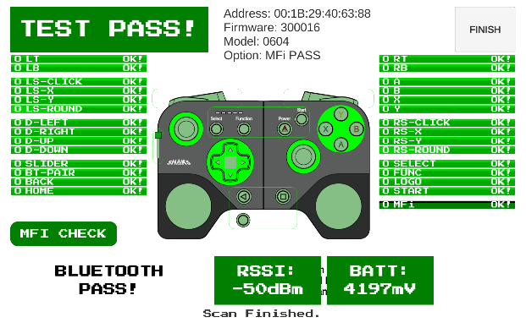
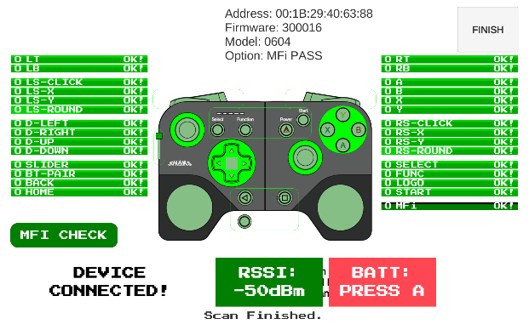

Before Bluetooth and Battery Check
Please unplug after all of test. If not finished test or some error, showing STOP! message and showing reasons.
If unplug, scanning gamepad automately. Press Power Button and waiting pairing. If showing Bluetooth pairing message, Click OK.
FAIL STATUS.
Scanning…
Found! Wait pairing.
Showing RSSI value.
If not found gamepad, press RE SCAN BLUETOOTH button. If count is zero, turn off Bluetooth and RE SCAN BLUETOOTH button.

Slide 23

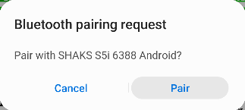
Bluetooth Check
3. If show “Bluetooth pairing request”, Press “Pair” button.
Press “Pair”

Slide 24
Bluetooth Check
Press “A” button for check battery.
If BATT value is 3900mV or over, test is passed.
If the game pad is connected but there is no response,
please turn off the game pad, turn it back on.
check if the game pad is automatically connected.

Slide 25
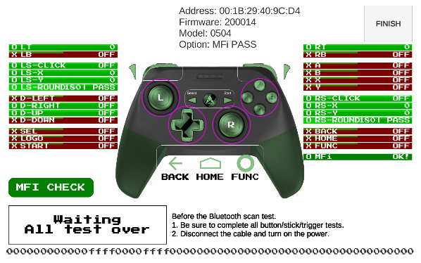
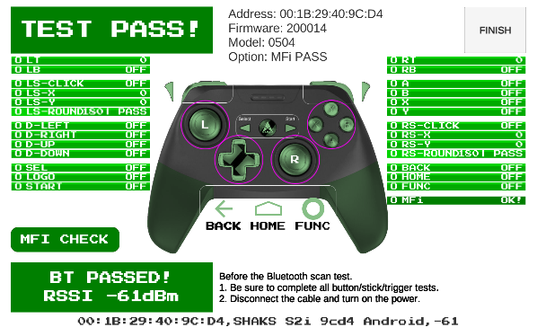
LOG VIEW
LOG area is showing usb raw signal(LEFT) or showing detected bluetooth information(RIGHT).

Slide 26
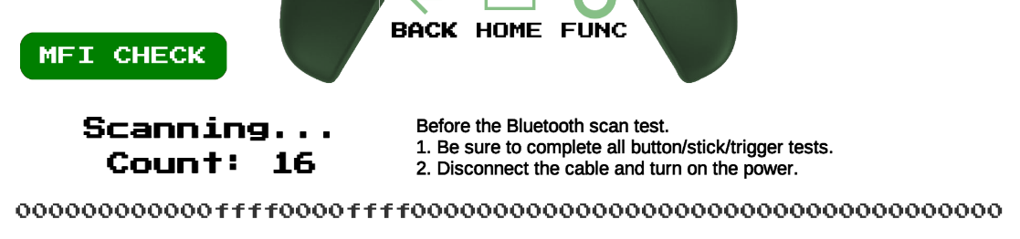
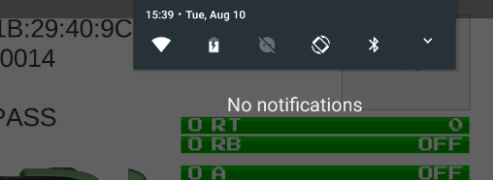
FAQ
Cannot Scanning and not showing/raising Count number.
Turn off Bluetooth in QuickTiles.
Close QuickTiles.
Press RE-SCAN BLUETOOTH twice.
Turn on Bluetooth → Discover Bluetooth.
QuickTile appears by
repeating the downward movement twice.

Slide 27
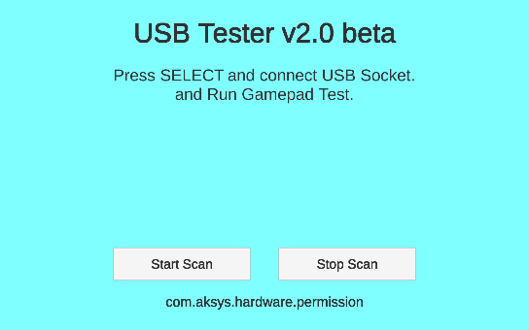
FAQ
Cannot launch test screen and showing com.aksys.hardware.permission under.
You’re not pressed debug-key.
Unplug gamepad and reconnect with press debug-key.

Slide 28
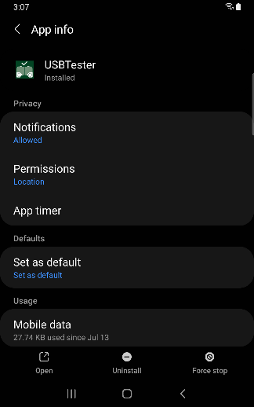
FAQ
Cannot change to Scanning and show RE-SCAN BLUETOOTH button again.
Your tablet(or smartphone) is denied location permission.
Go to System Setting → App → USBTester → Permissions → Location
Set to Allow only while using the app.

Slide 29
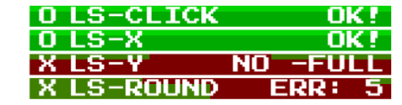
FAQ
LS/RS-ROUND is failed and What means ERR number?
You can see the unchecked direction. Please check the picture below and try moving the stick in that direction.
Please rotate a little slowly for accurate judgment.
It’s tested!
(0 to 4 and 15)
ERR number
1
0
15
2
14
3
13
4
12
5
11
6
10
7
8
9

